Slide 1

Introduction
presented by :--> JAYVIR SINGH
university :--> AKTU Lucknow U.P.
gitHub Link :-->https://github.com/JYR-86

Slide 2
Bake My Cake
Bake My Cake, that allows customers to make an online request for cakes, cookies, or brownies of their choice.

Slide 3

Application Brief
With a flourish, the app unfurls a treasury of epicurean pleasures, each dish a masterpiece of flavor and presentation. The senses are bewitched by the alluring images and poetic descriptions, immersing the users in a world of culinary enchantment. Once the feast is chosen, the app guides the users through each step, with a deft touch that ensures no missteps. From confirmation to completion, every detail is attended to, weaving a seamless spell of gastronomic delight.

Slide 4

Agenda
Develop a single page application using Angular – Bake My Cake
Allowing the users to select the item of their choice and provide the order details
Make thing eaiser for customer while selecting or ordering somthing from the list of food items

Slide 5





Technology Used
HTML
CSS
TypeScript
Angular Framework
Material UI
JSON-SERVER

Slide 6
Problem Statement
The delicacies are displayed with attractive images and crisp details.
Allowing the users to select the item of their choice and provide the order details.
The app can search and filter the items by the user’s preference for a quick selection.
The app should redirect user to first validate his identity as site administrator before providing access to the order request view.

Slide 7
Architecture
Components
Services
Models
AppComponent
FoodService
CartItem
HeaderComponent
SellerService
Items
LandingComponent
UserService
PriceSummary
FooterComponent
SellerLogin
CardComponent
SellerSignup
SearchComponent
UserLogin
FooterComponent
UserSignup
CustomerComponent
CustomerHomeComponent
SellerComponent
SellerHomeComponent
SellerAddItemComponent
SellerListItemComponent
SellerUpdateItemComponent
ErrorComponent

Slide 8

Layout
Header
Landing View
Footer

Slide 9

Data-Flow
Application
Header
Router-Outlet
Footer
Seller
Default
User

Slide 10

Header Component
Default header
Seller header
User header
Home
Home
Item list
Login
Cart Item
Add Item
Seller
Logout
Logout
Contacts
Profile
Profile

Slide 11
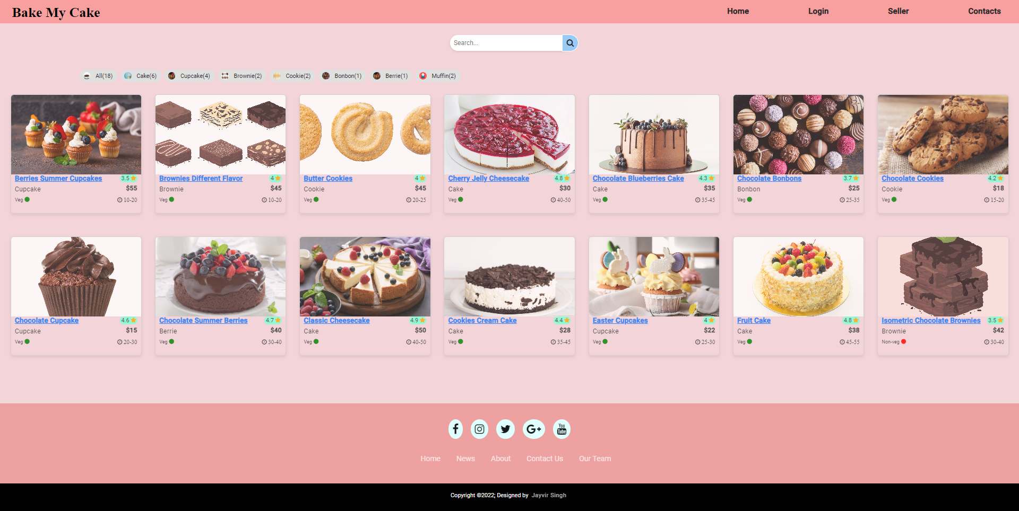
Default View

Slide 12
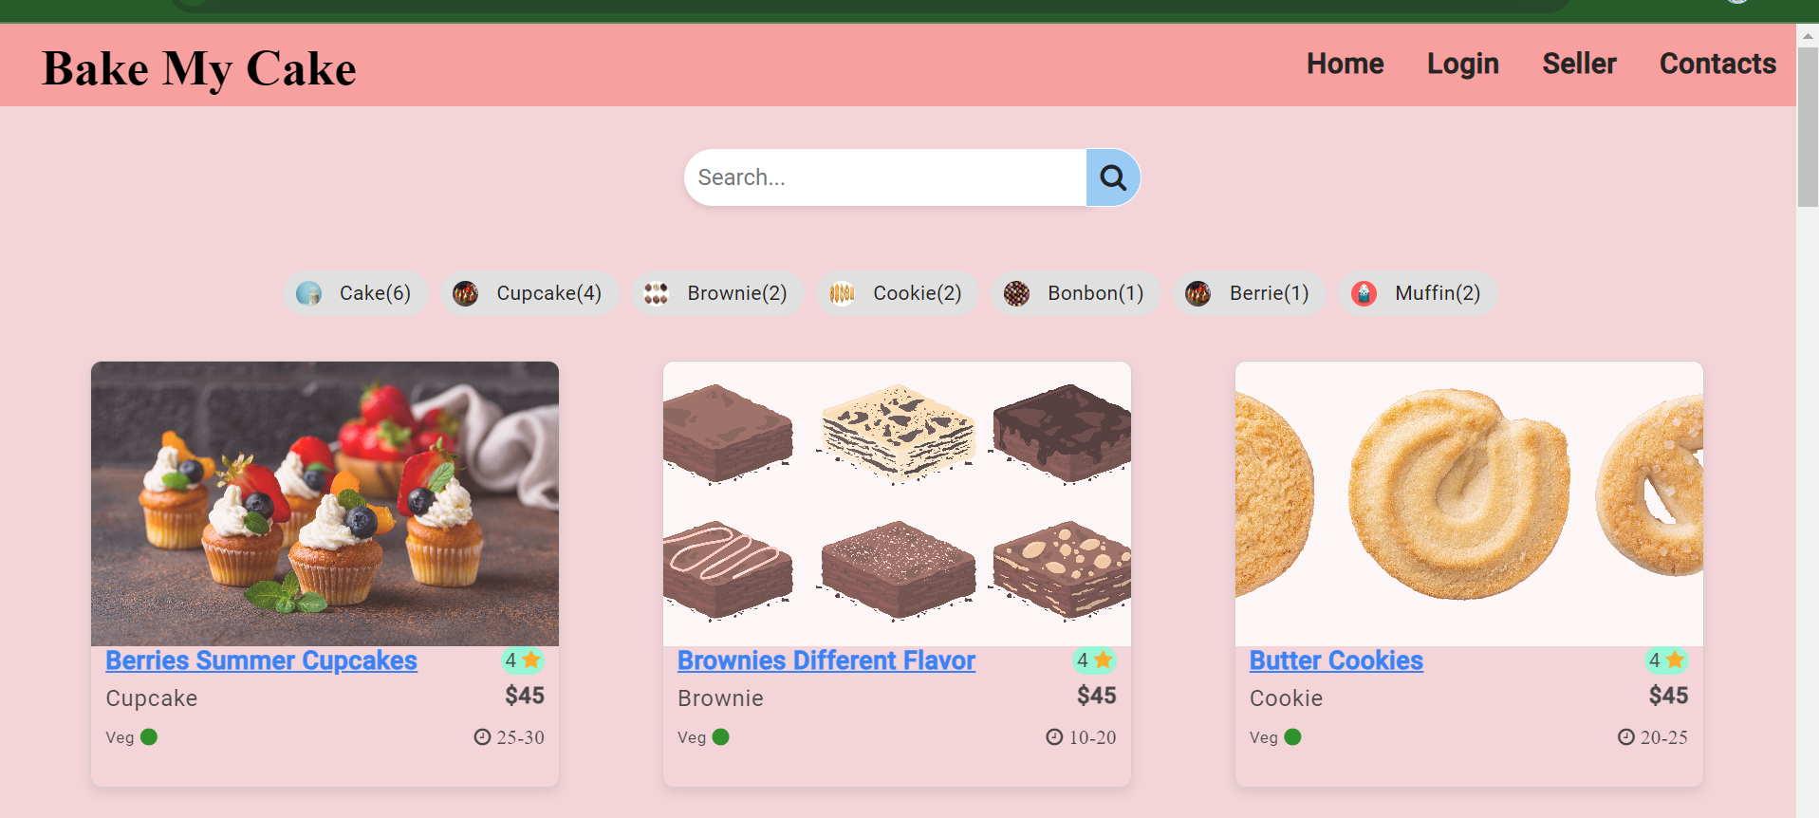

While clicking on it , opens user login page

Slide 13
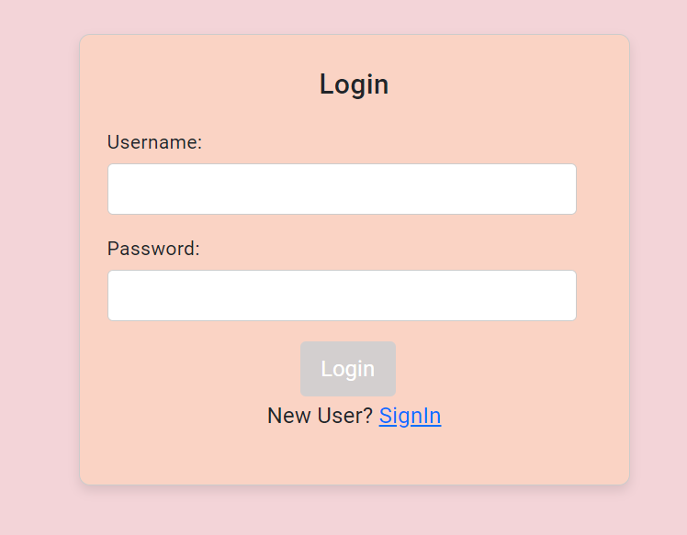
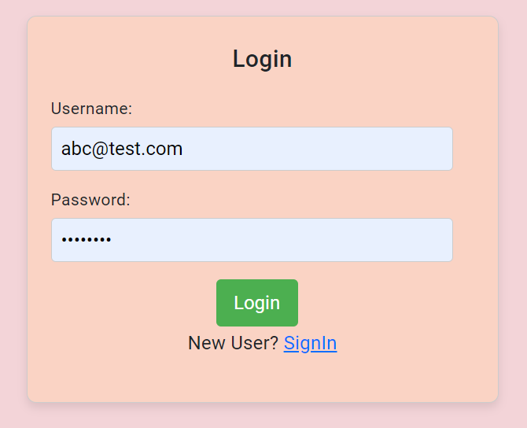
User Login Page
In the left side fields are empty thats why button is disabled
In the right side fields are fill now button is enable

Slide 14
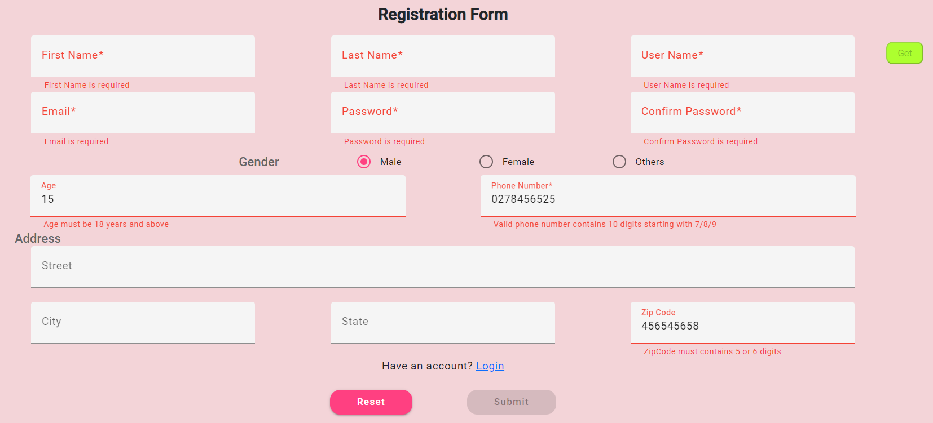
User Signup Page
Here form validations are applied using reactive form and custome validation with proper messages.
In this there is an auto username generator which we use to login user.

Slide 15
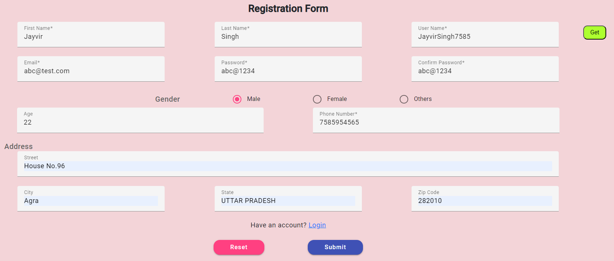
User Signup Page Cont...
Now button is enable after all fields are correctly filled.

Slide 16
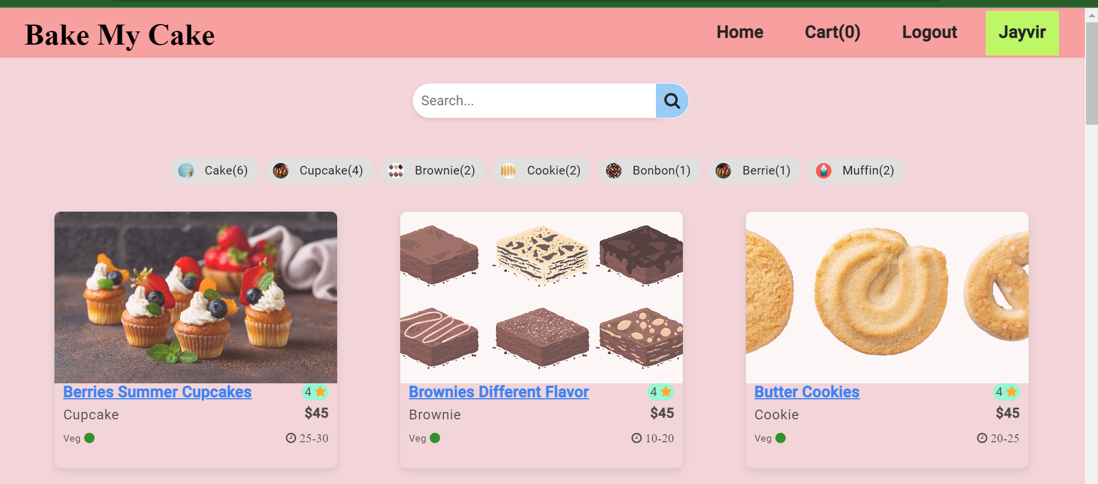
Only after login, logout enables
User Login Signature
Cart option with order count

Slide 17
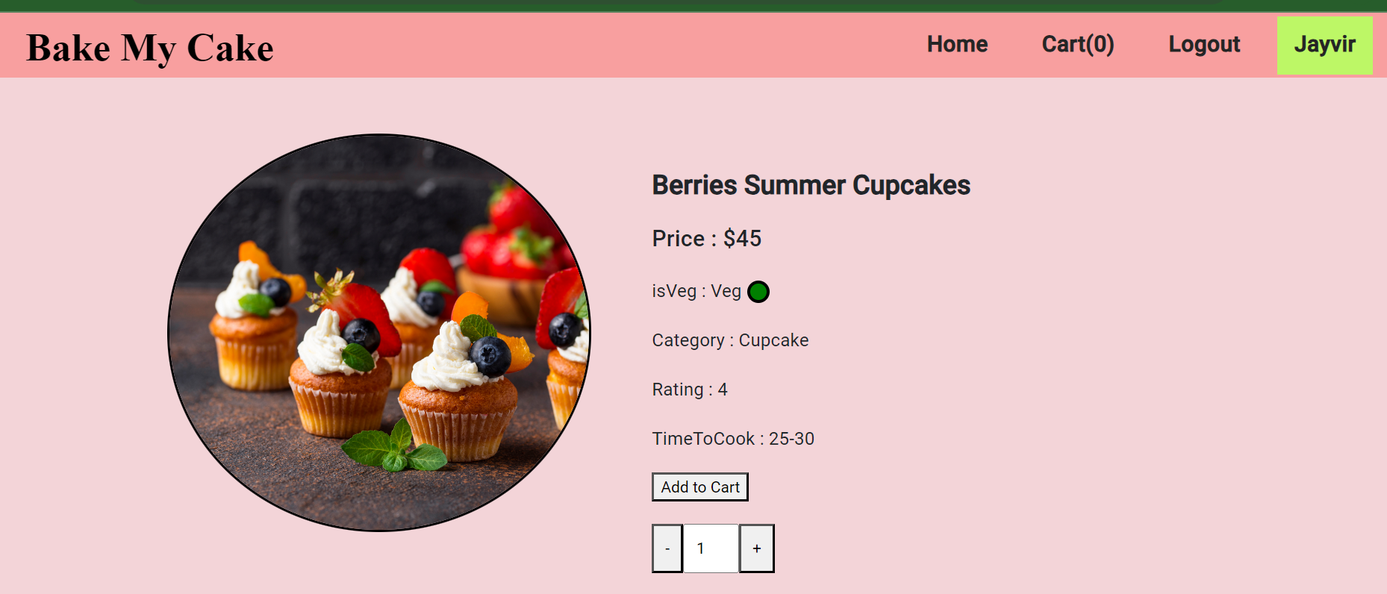
When user click on any item then it render the user into the item details page
After click on add to cart button, it will disappers and if you want to order same product you can do that from the home page

Slide 18
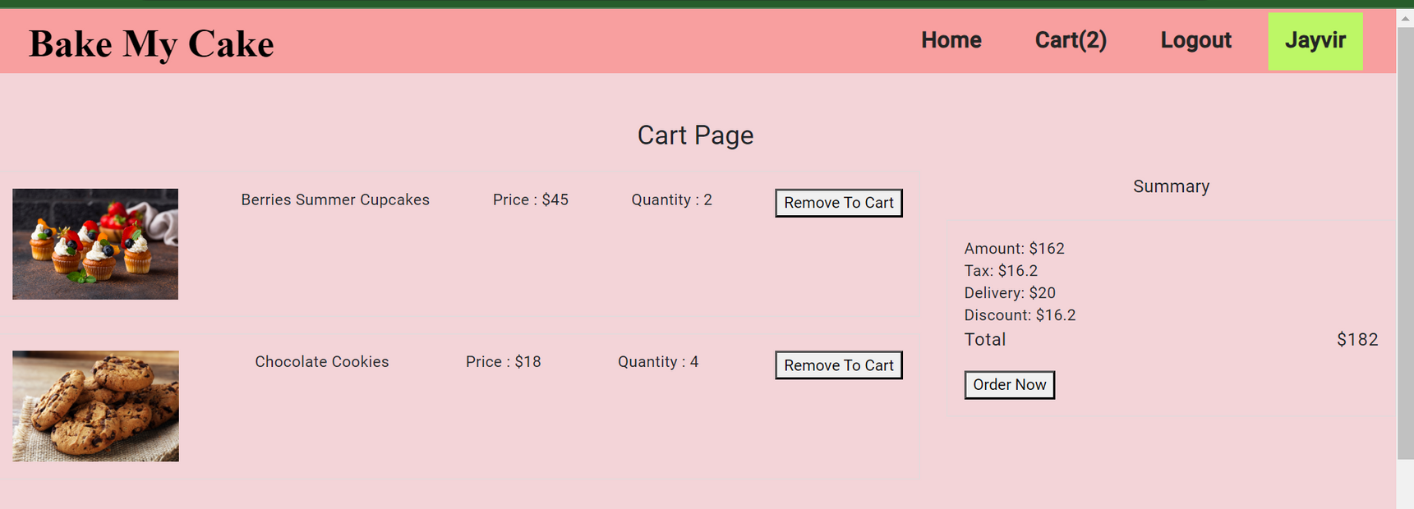
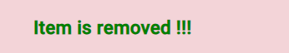

Now user is in the cart page where he can remove the item or can finalize or order the item.
This page contains the cart details and the final amount after all taxes and all the price etc.
After click on Order now button the data is sent to the backend server(JSON-Server) from there admin can get the order details.

Slide 19
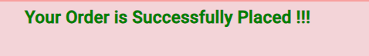
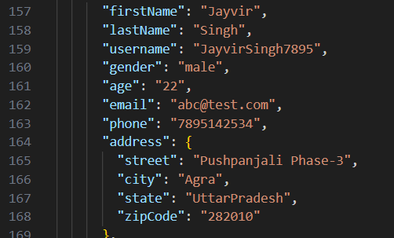
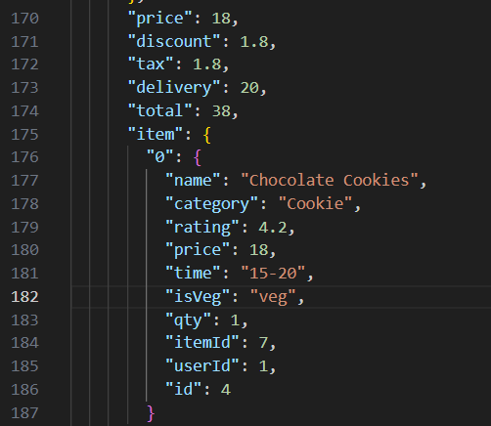
Final Order Data in Server

Slide 20
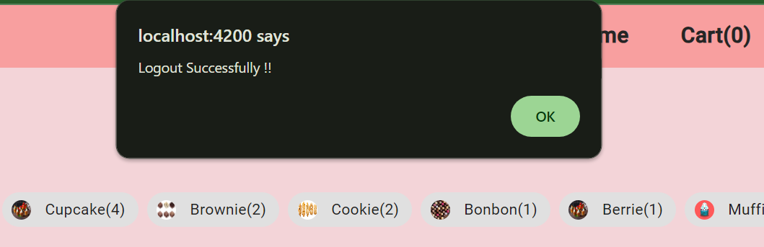
After Completing order Logout is performed and one alert is sent.

Slide 21
From here seller/admin can navigate to their view

Slide 22
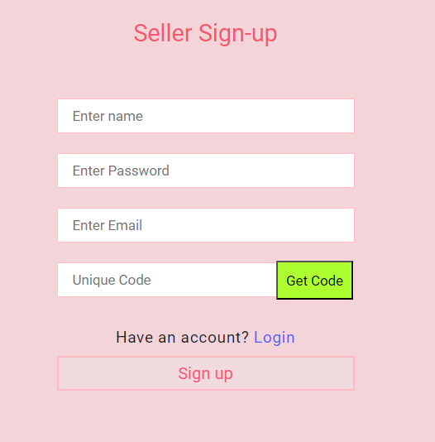
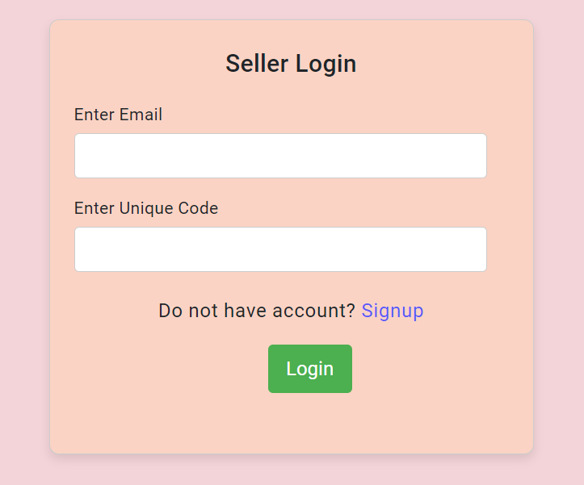
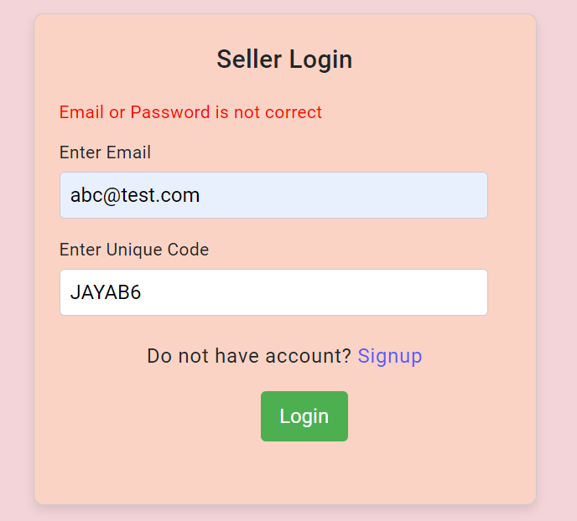
Seller Login/Signup Page
Special note** auto generated Get Code is there which is enable to login admin
On wrong email or uniqueCode there is error message will display.

Slide 23
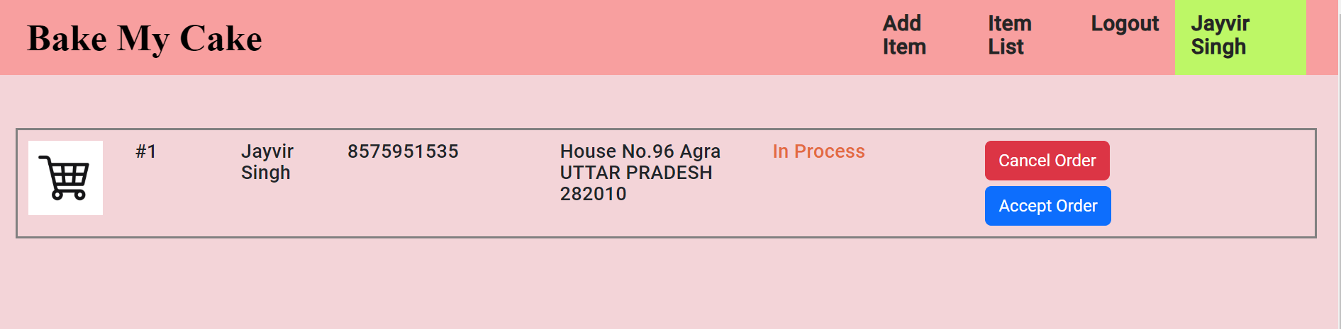
Seller View
Seller/Admin view is defined to accept or reject the order in accordance with the conditions.
Here i am using a dynamic message like in procces and accepted after click on accept order button.

Slide 24
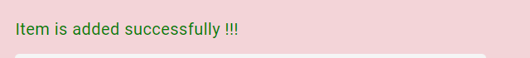
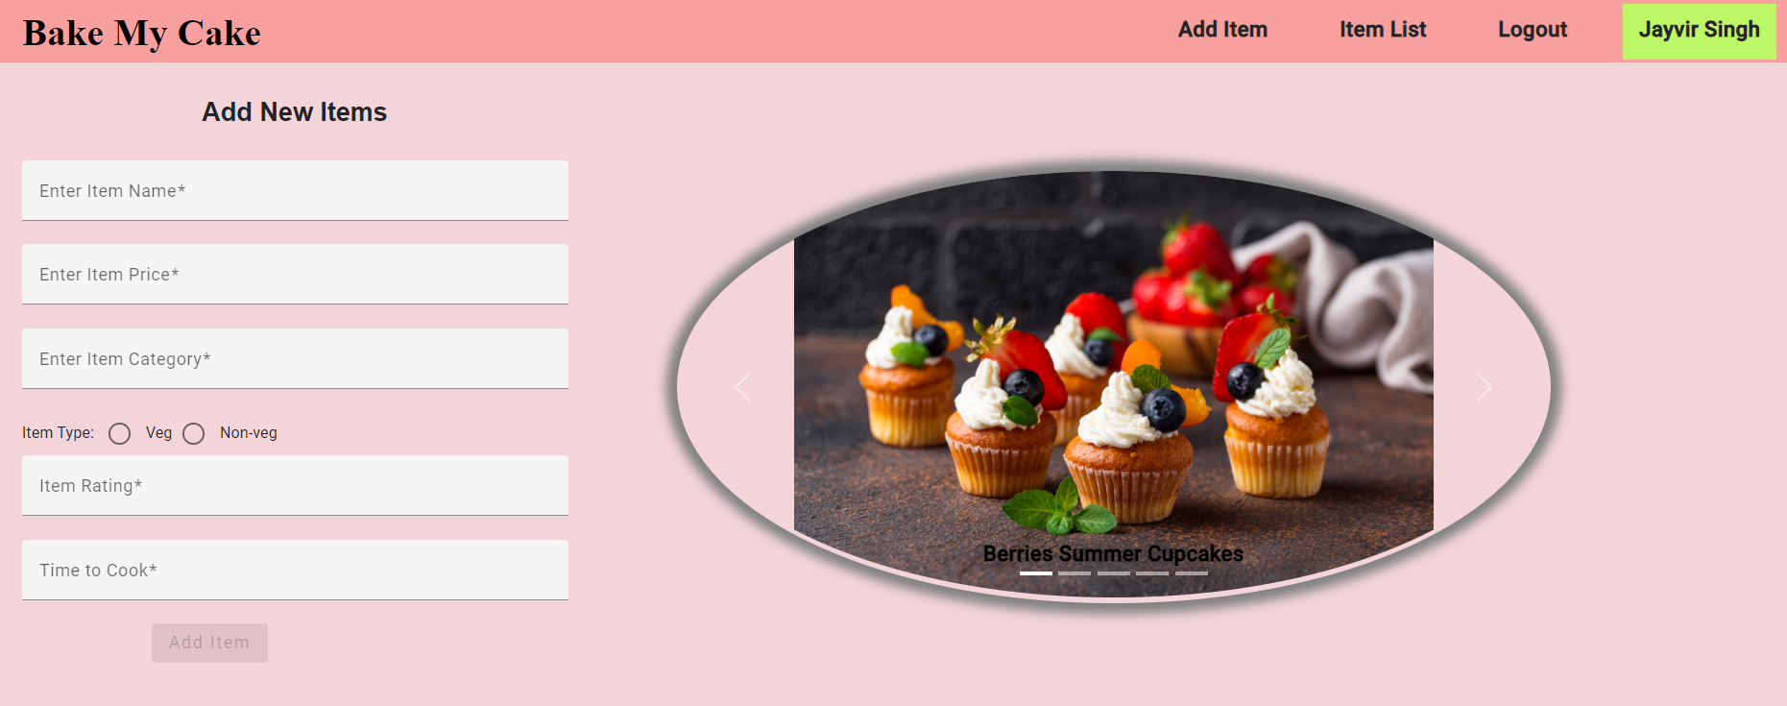
This option is avaliable for admin to add new products in the food list

Slide 25


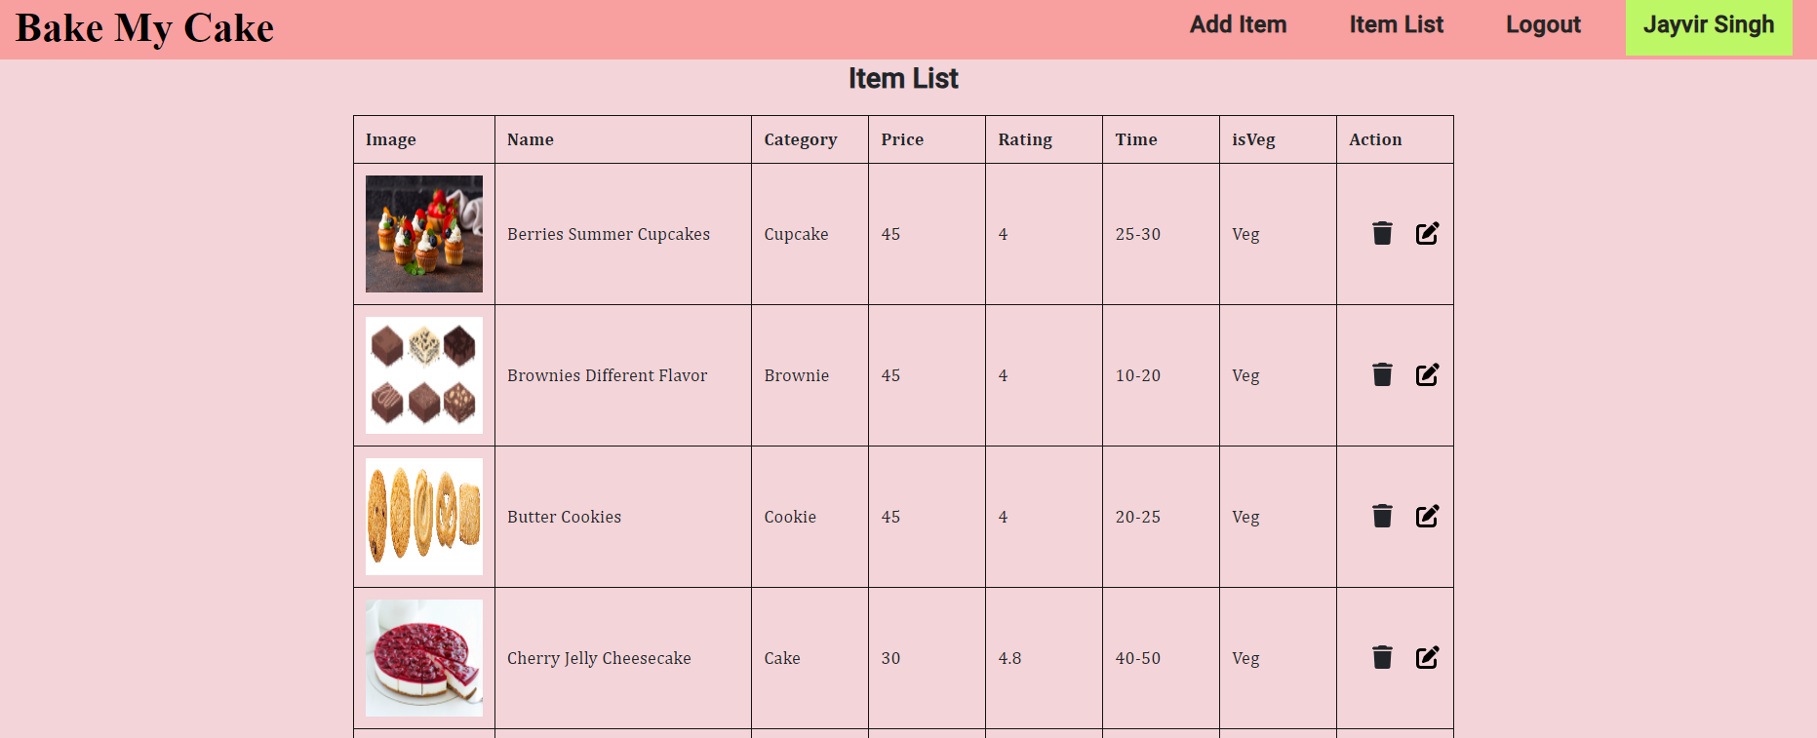
This option is avaliable for admin to customise and list the items which are present in the application for user to buy.
Option to update the item
Option to remove the item

Slide 26

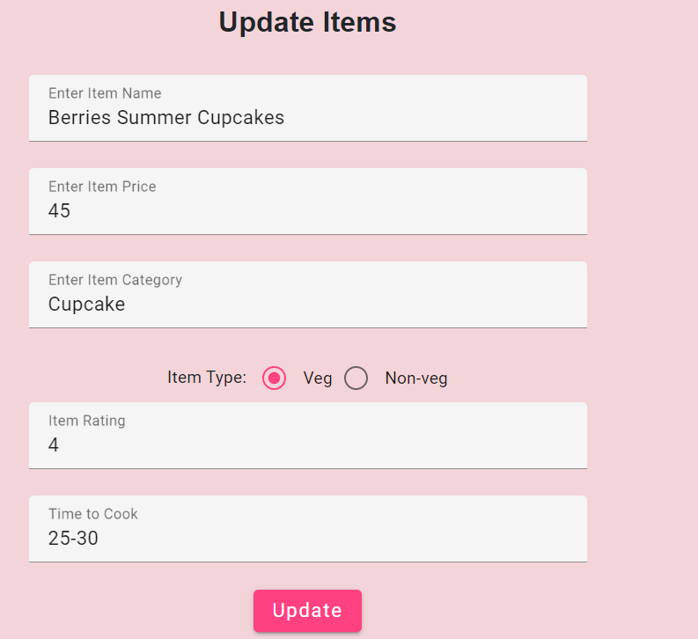
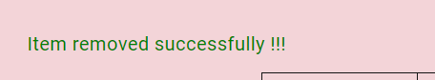
Admin have rights to update price and all things into their items so , to do that there is an option for update item.
A regular success message is shown after the update.
Now item is updated and you can check it into the list and user view also.
Logout option is there ...

Slide 27
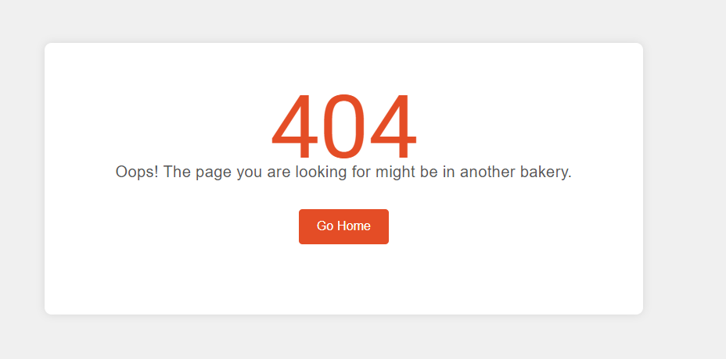
Wild Card
Wildcard/Page Not Found is the common page for all the disconnectivity of pages navigation
Main reason of using this is to show user that there is a breakage between your transferd request and sometimes its also happend because of bugges.

Slide 28

Fantastic Footer
Generally it contains all the social and networking details and links to get to know mre about the designer of the application and its work of experience.

Slide 29
Key Features of the Project
@Input() and @Output() decorators: These decorators are used to communicate data between parent and child components.
Angular services: Services are used to provide reusable application logic.
HttpChent: This service is used to make HTTP requests to a server.
ngOnInit() life cycle hook: This hook is used to initialize a component when it is first created.
Template/Reactive driven forms: These forms are used to create interactive form fields.
Angular Router: This router is used to enable navigation between different pages in the application.
Route Guards: These guards are used to protect routes with restricted access.

Slide 30
Guester towards my mentor and myself !!!!
Thankyou to my self
Thankyou to NIIT
Thankyou to Saurabh sir
Thankyou to Rajeshwar sir
Thankyou to Priyanka mam

Slide 31

ThankYou !!!

